Slide 1
Diamond District
Collective Impact

Slide 2
This research was funded in part by the Annie E. Casey Foundation. We thank them for their support but acknowledge that the findings and conclusions presented in this report are those of the author(s) alone, and do not necessarily reflect the opinions of the Foundation.

Slide 3
Diamond District

Slide 4
Overview
Diamond District Population
In 2003
In 2013
3 percent
85,124
87,772

Slide 5
Overview
Race/Ethnicity
Notes:
Source: 2012 5-year American Community Survey (ACS) data.

Slide 6
Overview
Age Distribution
Diamond District
Median Age
29.6 years
San Diego County
Median Age
34.7 years
Notes:
Source: 2012 5-year American Community Survey (ACS) data.

Slide 7
Overview
Place of Birth
Notes:
Source: 2012 5-year American Community Survey (ACS) data.

Slide 8
Overview
Citizenship Status of Foreign Born
Notes:
Source: 2012 5-year American Community Survey (ACS) data.

Slide 9
Overview
World Region of Birth of Foreign-Born Population
Notes:
Source: 2012 5-year American Community Survey (ACS) data.

Slide 10
Economic Vitality
Top 5 Industries in…
Diamond District (n=1,513)
1. Administrative & Support, Waste Management, Remediation Services | 17%
2. Other Services (except Public Administration) | 15%
3. Retail Trade | 9%
4. Professional, Scientific, and Technical Services | 8%
5. Transportation and Warehousing | 6%
City of San Diego (n=57,690)
Professional, Scientific, and Technical Services | 23%
2. Other Services (except Public Administration) | 14%
Construction | 8%
4. Retail Trade | 7%
5. Health Care and Social Assistance | 7%
Notes:
1. The Administrative and Support and Waste Management and Remediation Services sector comprises establishments performing routine support activities for the day-to-day operations of other organizations. Examples: Admin & Support, Janitorial, Landscaping Services, Other Services to Buildings & Dwellings
2. The Other Services (except Public Administration) sector comprises establishments engaged in providing services not specifically provided for elsewhere in the classification system. Establishments in this sector are primarily engaged in activities, such as equipment and machinery repairing, promoting or administering religious activities, grantmaking, advocacy, and providing drycleaning and laundry services, personal care services, death care services, pet care services, photofinishing services, temporary parking services, and dating services.
The Professional, Scientific, and Technical Services sector comprises establishments that specialize in performing professional, scientific, and technical activities for others. These activities require a high degree of expertise and training.
Source: ESRI

Slide 11
Businesses in the Diamond District
Notes:
Source: ESRI

Slide 12
Economic Vitality
Employment by Industry (Top 5)
Diamond District (n=32,767)
1. Education, Social Services, Health | 18%
2. Arts, Entertainment, Recreation | 16%
3. Professional, Scientific, and Technical Services | 12%
4. Retail Trade | 10%
Manufacturing | 9%
San Diego County (n=1,386,825)
Education, Social Services, Health | 21%
2. Professional, Scientific and Technical Services | 14%
3. Retail Trade | 11%
4. Arts, Entertainment, Recreation | 11%
5. Manufacturing | 9%
Notes:
Note: Top 5 industries of employment of residents within each geographic area. This may not match the industries in each community previously shown- as some residents travel outside the area for work.
Source: 2012 5-year American Community Survey (ACS) data.
Note 2: The Arts, Entertainment, and Recreation sector includes a wide range of establishments that operate facilities or provide services to meet varied cultural, entertainment, and recreational interests of their patrons. This sector comprises (1) establishments that are involved in producing, promoting, or participating in live performances, events, or exhibits intended for public viewing; (2) establishments that preserve and exhibit objects and sites of historical, cultural, or educational interest; and (3) establishments that operate facilities or provide services that enable patrons to participate in recreational activities or pursue amusement, hobby, and leisure-time interests. Examples: DJs, musicians, gyms, clowns, bouncy house rentals, etc.

Slide 13
Economic Vitality
Employment by Industry
Notes:
Source: 2012 5-year American Community Survey (ACS) data.

Slide 14
Economic Vitality
Occupations
Notes:
Source: 2012 5-year American Community Survey (ACS) data.

Slide 15
Economic Vitality
Household (HH) Income Distribution
Diamond District
Median HH Income
$46,562
San Diego County
Median HH Income
$73,969
Notes:
Source: 2012 5-year American Community Survey (ACS) data.

Slide 16
Economic Vitality
Household Income and Benefits
Notes:
Source: 2012 5-year American Community Survey (ACS) data.

Slide 17
Economic Vitality
Households (HH) with Public Assistance
Notes:
Source: 2012 5-year American Community Survey (ACS) data.

Slide 18
Economic Vitality
Median Earnings by Educational Attainment
Population 25 years and over with earnings
Diamond District
Median Earnings
$25,252
San Diego County
Median Earnings
$39,572
Notes:
Source: 2012 5-year American Community Survey (ACS) data.

Slide 19
Economic Vitality
Percentage of Population Living at Poverty (using Federal Definition)
Notes:
Source: 2013 5-year American Community Survey (ACS) data.

Slide 20
Economic Vitality
Percentage of Population Earning Less than Self-Sufficiency Standard
Households* earning less than $24,999
Diamond District: 29%
San Diego County: 19%
Self-Sufficiency Standard:
$27,655 for 1 adult
Families** earning less than $49,999
Diamond District: 55%
San Diego County: 40%
Self-Sufficiency Standard:
$53,580 for a family with 1 adult + 1 preschooler
* Households may include multiple adults
** Family defined as blood relative, marriage (may or may not include child(ren))
Notes:
Data Source: 2013 5-year American Community Survey (ACS) data
Self-Sufficiency Standard:
Making Ends Meet Report, Center on Policy Matters and Insight Center for Community Economic Development, 2014. http://www.onlinecpi.org/making_ends_meet

Slide 21
Economic Vitality
Income to Poverty Ratio in Households

Slide 22
Economic Vitality
Labor Force Status of Civilian Non-institutionalized
Population 18-64 years
Notes:
Source: 2012 5-year American Community Survey (ACS) data.

Slide 23
Economic Vitality
Housing Occupancy
Notes:
Source: 2012 5-year American Community Survey (ACS) data.

Slide 24
Economic Vitality
Median Value Homes
Median Gross
Rent
Diamond District
$275,711
Diamond District
$1,062
San Diego County
$432,750
San Diego County
$1,282
Notes:
Source:
Median Value Homes: Zillow Research. Median home sale prices for 2013-06 (by zip code)
Rent: 2012 5-year American Community Survey (ACS) data.

Slide 25
Education, Skills, and Competencies
Overall Educational Attainment
Notes:
Source: 2012 5-year American Community Survey (ACS) data.

Slide 26
Education, Skills, and Competencies
Educational Attainment by Race/Ethnicity in the Diamond District (Population 25 years an older)
* Race includes Hispanic/Latino populations
Notes:
Source: 2013 5-year American Community Survey (ACS) data. Tables C15002H, C15002B, C15002D, C15002F, and C15002I.
Population 25 years and older.

Slide 27
Education, Skills, and Competencies
Diamond District Schools
Elementary Schools
Baker
Carver
Chollas/Mead
Encanto
Holly Drive Leadership Academy (K-8) (Elementary)
Horton
Johnson
Nye
Oak Park
Porter Elementary
Valencia Park
Webster
Middle Schools
Millennial Tech
O'Farrell Community School (K-12) (Middle - K-9 served)
Knox Middle School
High Schools
Gompers Preparatory Academy
Lincoln High School

Slide 28
Education, Skills, and Competencies
Characteristics of Students in Public Schools
Notes:
Source: California Department of Education, DataQuest, Custom Reports

Slide 29
Education, Skills, and Competencies
Elementary School API Scores – 10 Year Change
Notes:
Source: California Department of Education, DataQuest: SAT Report (2012-2013)

Slide 30
Education, Skills, and Competencies
Percent of 12th Grade Students Taking the SAT
Notes:
Source: California Department of Education, DataQuest: SAT Report (2012-2013)

Slide 31
Education, Skills, and Competencies
SAT Scores: 2012-2013
Notes:
Source: California Department of Education, DataQuest: SAT Report (2012-2013)

Slide 32
Education, Skills, and Competencies
Percent of Resident vs Incoming Students (2013-14)

Slide 33
Education, Skills, and Competencies
Graduates with Postsecondary Enrollment 1-Year Post Graduation
Notes:
Note: Diamond District data includes Lincoln High School data from 2007-2013 and Gompers Preparatory data from 2011-2013.
Source: National Student Clearinghouse, Postsecondary enrollment data (2007-2013)

Slide 34
Education, Skills, and Competencies
Post Secondary Education by 2 year and 4 year Institutions
Notes:
Note: Diamond District data includes Lincoln High School data from 2007-2013 and Gompers Preparatory data from 2011-2013.
Note 2: Data may not add to 100 percent. Those enrolled in less than 2 year institutions not reported on chart.
Source: National Student Clearinghouse, Postsecondary enrollment data (2007-2013)

Slide 35
Public Safety
Violent Crime (per 1,000 population)
Diamond District
37% drop in 10 years
San Diego County
21% drop in 10 years
Diamond District 48% HIGHER than San Diego County
Notes:
Violent crimes include homicide, rape, robbery, and aggravated assault.
Sources
County Data: SANDAG, Thirty Years of Crime in the San Diego Region Report (http://www.sandag.org/uploads/publicationid/publicationid_1848_17457.pdf)
Diamond District Data: San Diego City Crime Statistics by Neighborhood Reports (http://www.sandiego.gov/police/services/statistics/index.shtml)

Slide 36
Public Safety
Breakdown of Violent Crime in the Diamond District
Notes:
Diamond District Data: San Diego City Crime Statistics by Neighborhood Reports (http://www.sandiego.gov/police/services/statistics/index.shtml)

Slide 37
Public Safety
Property Crime (per 1,000 population)
Diamond District
28% drop in 10 years
San Diego County
31% drop in 10 years
Diamond District 14% LOWER than San Diego County
Notes:
Property Crime includes burglary, larceny, and motor vehicle theft.
Sources
County Data: SANDAG, Thirty Years of Crime in the San Diego Region Report (http://www.sandag.org/uploads/publicationid/publicationid_1848_17457.pdf)
Diamond District Data: San Diego City Crime Statistics by Neighborhood Reports (http://www.sandiego.gov/police/services/statistics/index.shtml)

Slide 38
Public Safety
2013 Alcohol and Narcotics Arrests (per 1,000 population)
Diamond District 65% LOWER Alcohol arrests than City of San Diego
Diamond District 18% LOWER Narcotics arrests than City of San Diego
Notes:
Note: Alcohol and Narcotics Arrest Data for 2013 arrests.
Sources
San Diego City Police Department, Clery Act Campus crime Reports, 2013 Alcohol Arrests, (http://www.sandiego.gov/police/services/statistics/cleryact.shtml)
San Diego City Police Department, Clery Act Campus crime Reports, 2013 Narcotics Arrests, (http://www.sandiego.gov/police/services/statistics/cleryact.shtml)

Slide 39
Health & Wellness
Top 5 Cause of Death
Diamond District (n=1,220)
Heart Disease ……………….. 25.2%
Cancers ………….…………... 24.7%
Other Causes ………………... 20.2%
Unintentional Injuries ………….. 5.2%
Stroke ……………………….… 5.0%
San Diego County
(n=19,925)
Cancers ……...………………. 24.8%
Heart Disease ………………... 23.1%
Other Causes ……………….... 20.5%
Alzheimer’s Disease …………… 5.8%
Chronic Lower Respiratory
Disease ……………………… 5.1%
Notes:
Source: California Department of Public Health, Death Profiles by Zip Code (2012)

Slide 40
Health & Wellness
Age at Death
Notes:
Source: California Department of Public Health, Death Profiles by Zip Code (2012)

Slide 41
Health & Wellness
Health Insurance Coverage by Source
Notes:
Note: Amounts may total more than 100 percent, as individuals can have both private and public insurance.
Source: 2012 5-year American Community Survey (ACS) data.

Slide 42
Health & Wellness
Births to Teen Mothers
Notes:
Source: California Department of Public Health, Birth Profiles by Zip Code (2012)

Slide 43
Health & Wellness
Birth Weight
Notes:
Source: California Department of Public Health, Birth Profiles by Zip Code (2012)

Slide 44
Health & Wellness
Immunization Status of Kindergarten Students
Notes:
Source: California Department of Public Health, CA Kindergarten Data (2013-2014)

Slide 45
Health & Wellness
Body Composition of 9th Graders
Notes:
Source: California Department of Education, California Physical Fitness Test (2013-2014)

Slide 46
Health & Wellness
Percent of Population Residing more than 1 mile from Grocery Store
Notes:
Note: Low access to a grocery store or healthy, affordable food retail outlet. Census tract at 1 mile for urban areas or 10 miles for rural areas.
Source: United States Department of Agriculture, Economic Research Service, Last updated: Friday, October 31, 2014

Slide 47
Health & Wellness
Dental Establishments (per 1,000 people)
Notes:
Sources:
San Diego County: 6212 Offices of Dentists, 2012 Business Patterns, American Fact Finder
Diamond District: Google Maps search (using 2013 population data), January 6, 2015
Information regarding correlation of dental health and poverty. “In general, children from low-income families experience the greatest amount of oral disease, the most extensive disease, and the most frequent use of dental services for pain relief. Yet these children have the fewest overall dental visits. Paradoxically, children in poverty—those living in households with annual gross incomes under $16 500 for a family of 4—or near poverty—those in family households with incomes between $16 500 and $33 000—also have the highest rates of dental insurance coverage, primarily through Medicaid and SCHIP. For those most affected, dental disease is consequential for their growth, function, behavior, and comfort.”
http://www.sciencedirect.com/science/article/pii/S1530156705600974

Slide 48
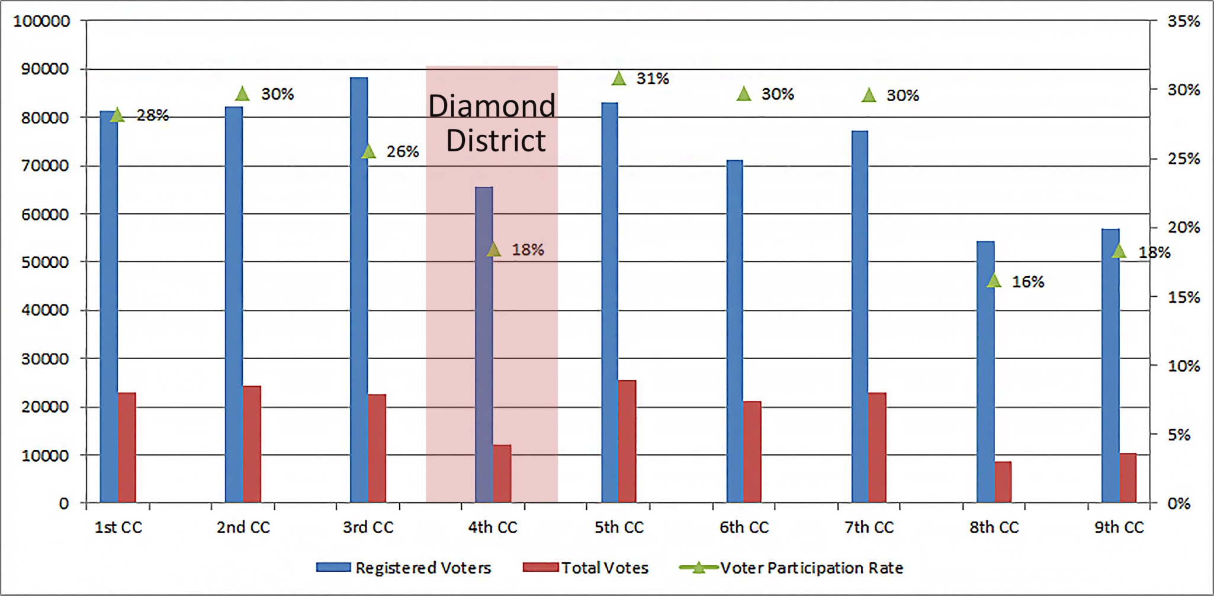
Civic Participation
Voter Participation in June 2014 Special Election by City Council (CC) Districts
Notes:
Source: San Diego Registrar of Voters

Slide 49
Civic Participation
2012 Presidential Election Voter Statistics
Notes:
Source: San Diego Registrar of Voters

Slide 50
Civic Participation
2012 Presidential Election Voter Statistics
Notes:
Source: San Diego Registrar of Voters

Slide 51
Character of Community Life
Method of Commuting to Work
Mean Travel Time to Work
25 minutes – Diamond District
24 minutes – San Diego County
Notes:
Source: 2012 5-year American Community Survey (ACS) data.

Slide 52
Character of Community Life
Diamond District - Euclid Avenue Trolley Stop Data
Notes:
Source: 2012 5-year American Community Survey (ACS) data.
* 2012 data not available due to transition in CALTRANS/SANDAG Automatic Passenger Counting Data change. 2012 used same data as 2011.

Slide 53
Character of Community Life
Ethnic Cuisine
Restaurants, caterers and other food services:
35% of Diamond District
TBD of San Diego County
Notes:
Source: ESRI

Slide 54
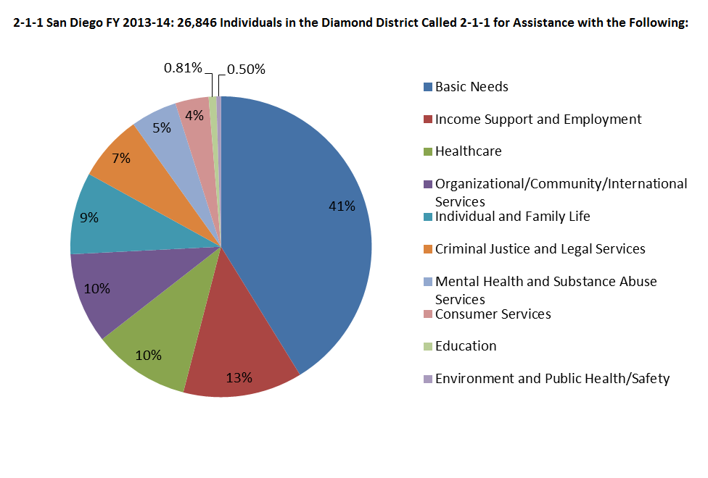
Character of Community Life
2-1-1 San Diego. Individuals in the Diamond District Called for Assistance with the Following:
Notes:
Source: 2-1-1 San Diego Data – Diamond District Information Sheet

Slide 55
Character of Community Life
Faith-Based Organizations in the Diamond District
196 places of worship, schools and social services
167 churches
1 mosque
3 temples
9 schools
15 social services
1 boarding home
Notes:
Zip codes: 92101, 92113, 92105, 92114
Sources:
Bing.com (keywords: religious schools in san diego, christian schools in san diego, faith-based organizations in san diego.)
Yelp.com (keywords: religious san diego, religious schools an diego)
Myservicemonster.com (search churches and religious organizations)
yellowpages.com (search churches and religious organizations)
Google.com (keywords: religious schools san diego, faith based organizations in san diego list)

Slide 56
Character of Community Life
Community
Diamond District
San Diego County
40.3% frequently talk with neighbors
65.5% do favors for their neighbors
89.9% frequently eat dinner with household members
To be completed by survey
Notes:
Source: Corporation for National & Community Service (NCoC) (http://www.volunteeringinamerica.gov/CA/San-Diego)

Slide 57
Character of Community Life
Volunteerism
Diamond District
San Diego County
(n=619,037)
29.7% of residents volunteer
619,000 volunteers
44.5 volunteer hours per resident
To be completed by survey
Notes:
Source: Corporation for National & Community Service (NCoC) (http://www.volunteeringinamerica.gov/CA/San-Diego)

Slide 58
Culture and Recreation
Public Library Book Circulation (per 1,000 people)
Notes:
Note: San Diego Public Library System includes libraries within the City of San Diego. City of San Diego population data used to determine circulation per 1,000 people.
Source: Annual Statistics for FY 2014, San Diego Public Library

Slide 59
Culture and Recreation
Recreation Parks
Diamond District
Chollas Lake Park
Encanto Recreation Center
Emerald Hills
Martin Luther King, Jr. Recreation Center
Mountain View Community Center
Willie Henderson Sports Complex
Per 1,000 people
Diamond District: 0.07 parks
City of San Diego: 0.06 parks
Notes:
Note: All recreation parks were only counted once. Some recreation parks had skate parks, tennis courts, and other programs.
Source: City of San Diego Parks and Recreation Department, data pulled 1/6/15

Slide 60
Culture and Recreation
Music & Performing Arts Venues in the Diamond District
3
Venues
Notes:
Note: Common Ground Theater, 4343 Ocean View Blvd, San Diego, CA 92113
TrueRoots
Jacobs
Source: Google (1/9/15)

Slide 61
Culture and Recreation
Art Galleries & Museums in the Diamond District
2
Art Galleries
0
Museums
Notes:
Note:
Source: Google (1/9/15)

Slide 62
Character of Physical Environment
Type of Housing (percentage)
Notes:
Source: 2012 5-year American Community Survey (ACS) data.
1. Diamond District: 27.05, 27.11, 27.12, 30.01, 30.03, 30.04, 31.01, 31.11, 31.12, 32.01, 33.01, 33.03, 33.04, 33.05, 34.01, 34.03, 34.04, 35.01, 35.02
2. County: San Diego County

Slide 63
Character of Physical Environment
Housing Snapshot
Notes:
Source: 2012 5-year American Community Survey (ACS) data.
1. Diamond District: 27.05, 27.11, 27.12, 30.01, 30.03, 30.04, 31.01, 31.11, 31.12, 32.01, 33.01, 33.03, 33.04, 33.05, 34.01, 34.03, 34.04, 35.01, 35.02
2. County: San Diego County

Slide 64
Character of Physical Environment
Housing Snapshot
Diamond District (n=24,275)
SD County (n=1,076,483)
Median Rooms:
4.7
Median Rooms:
5.1
Average Household Size: 3.7
Average Family Size: 4.2
Average Household Size: 2.8
Average Family Size: 3.4
Notes:
Source: 2012 5-year American Community Survey (ACS) data.
Diamond District Census Tract: 27.05, 27.11, 27.12, 30.01, 30.03, 30.04, 31.01, 31.11, 31.12, 32.01, 33.01, 33.03, 33.04, 33.05, 34.01, 34.03, 34.04, 35.01, 35.02

Slide 65
Character of Physical Environment
Percent Tree Canopy Area
Notes:
Source: USGS National Land Cover Dataset

